Slide 1

ADVENTURE WORKS
PROJECT DONE BY
Aishwarya kolikapongu
Harsh Dhananjay Mhatre
Medishetti Krishna Sai
Navya T
Punith K S
Rahul U
Saurav Raj

Slide 2
KEY OBJECTIVES
Data Integration and Calculation
Data Visualization and Reporting
Performance Analysis and Dashboard Creation

Slide 3

Overview
Company Overview
Adventure Works Cycles is a multinational manufacturing company that produces and sells bicycles globally.
Business Operations
Manufactures metal and composite bicycles
Sells to North American, European, and Asian markets
Has a manufacturing plant in Mexico for subcomponents
Assembles final products in Bothell location
Business Goals
Increase market share by targeting best customers
Expand product availability through an external website
Reduce production costs to lower cost of sales

Slide 4
Overview
Problem Overview:
Need: Enhance sales, revenue, and customer satisfaction through data analysis and visualization.
Challenge: Lack of integrated insights from separate data sources for informed decision-making.
Solution:
Tools Used: Excel, Power BI, MySQL, Tableau
Data Integration: Product, Customer, and Sales tables combined
Key Metrics: Sales Amount, Production Cost, Profit
Visualizations: Sales trends, charts, and dashboards created
Outcome:
Actionable Insights: Sales optimization, improved targeting, and marketing.
Business Impact: Faster decision-making, enhanced customer satisfaction, and better sales strategies.

Slide 5

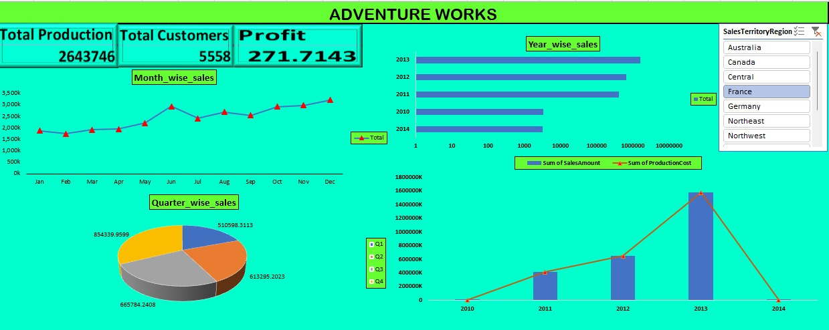
Excel Dashboard

Slide 6
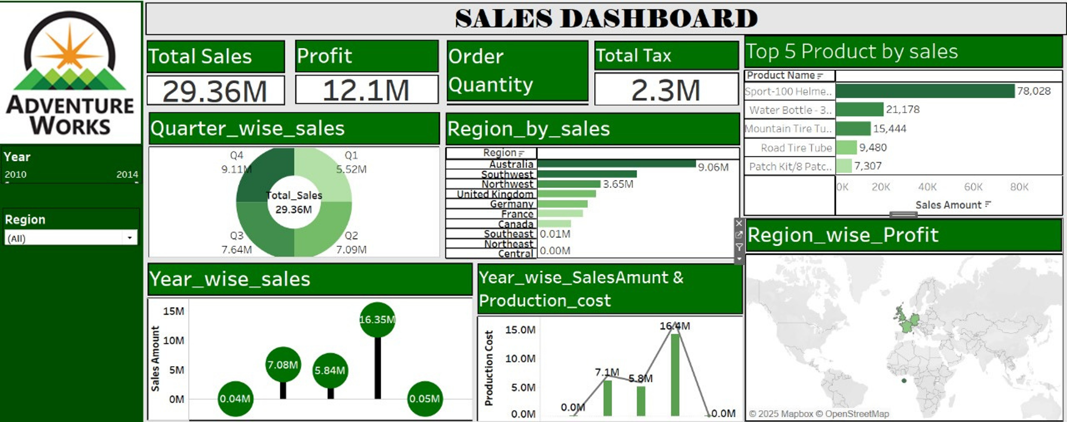
Tableau Dashboard

Slide 7
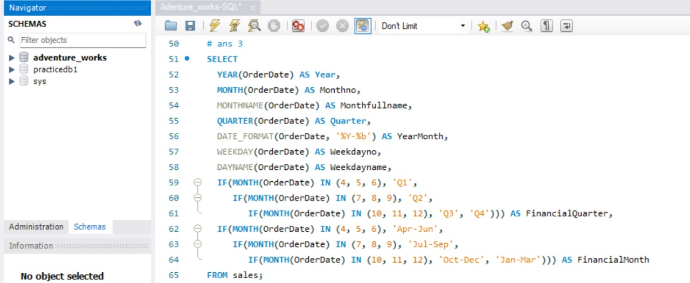
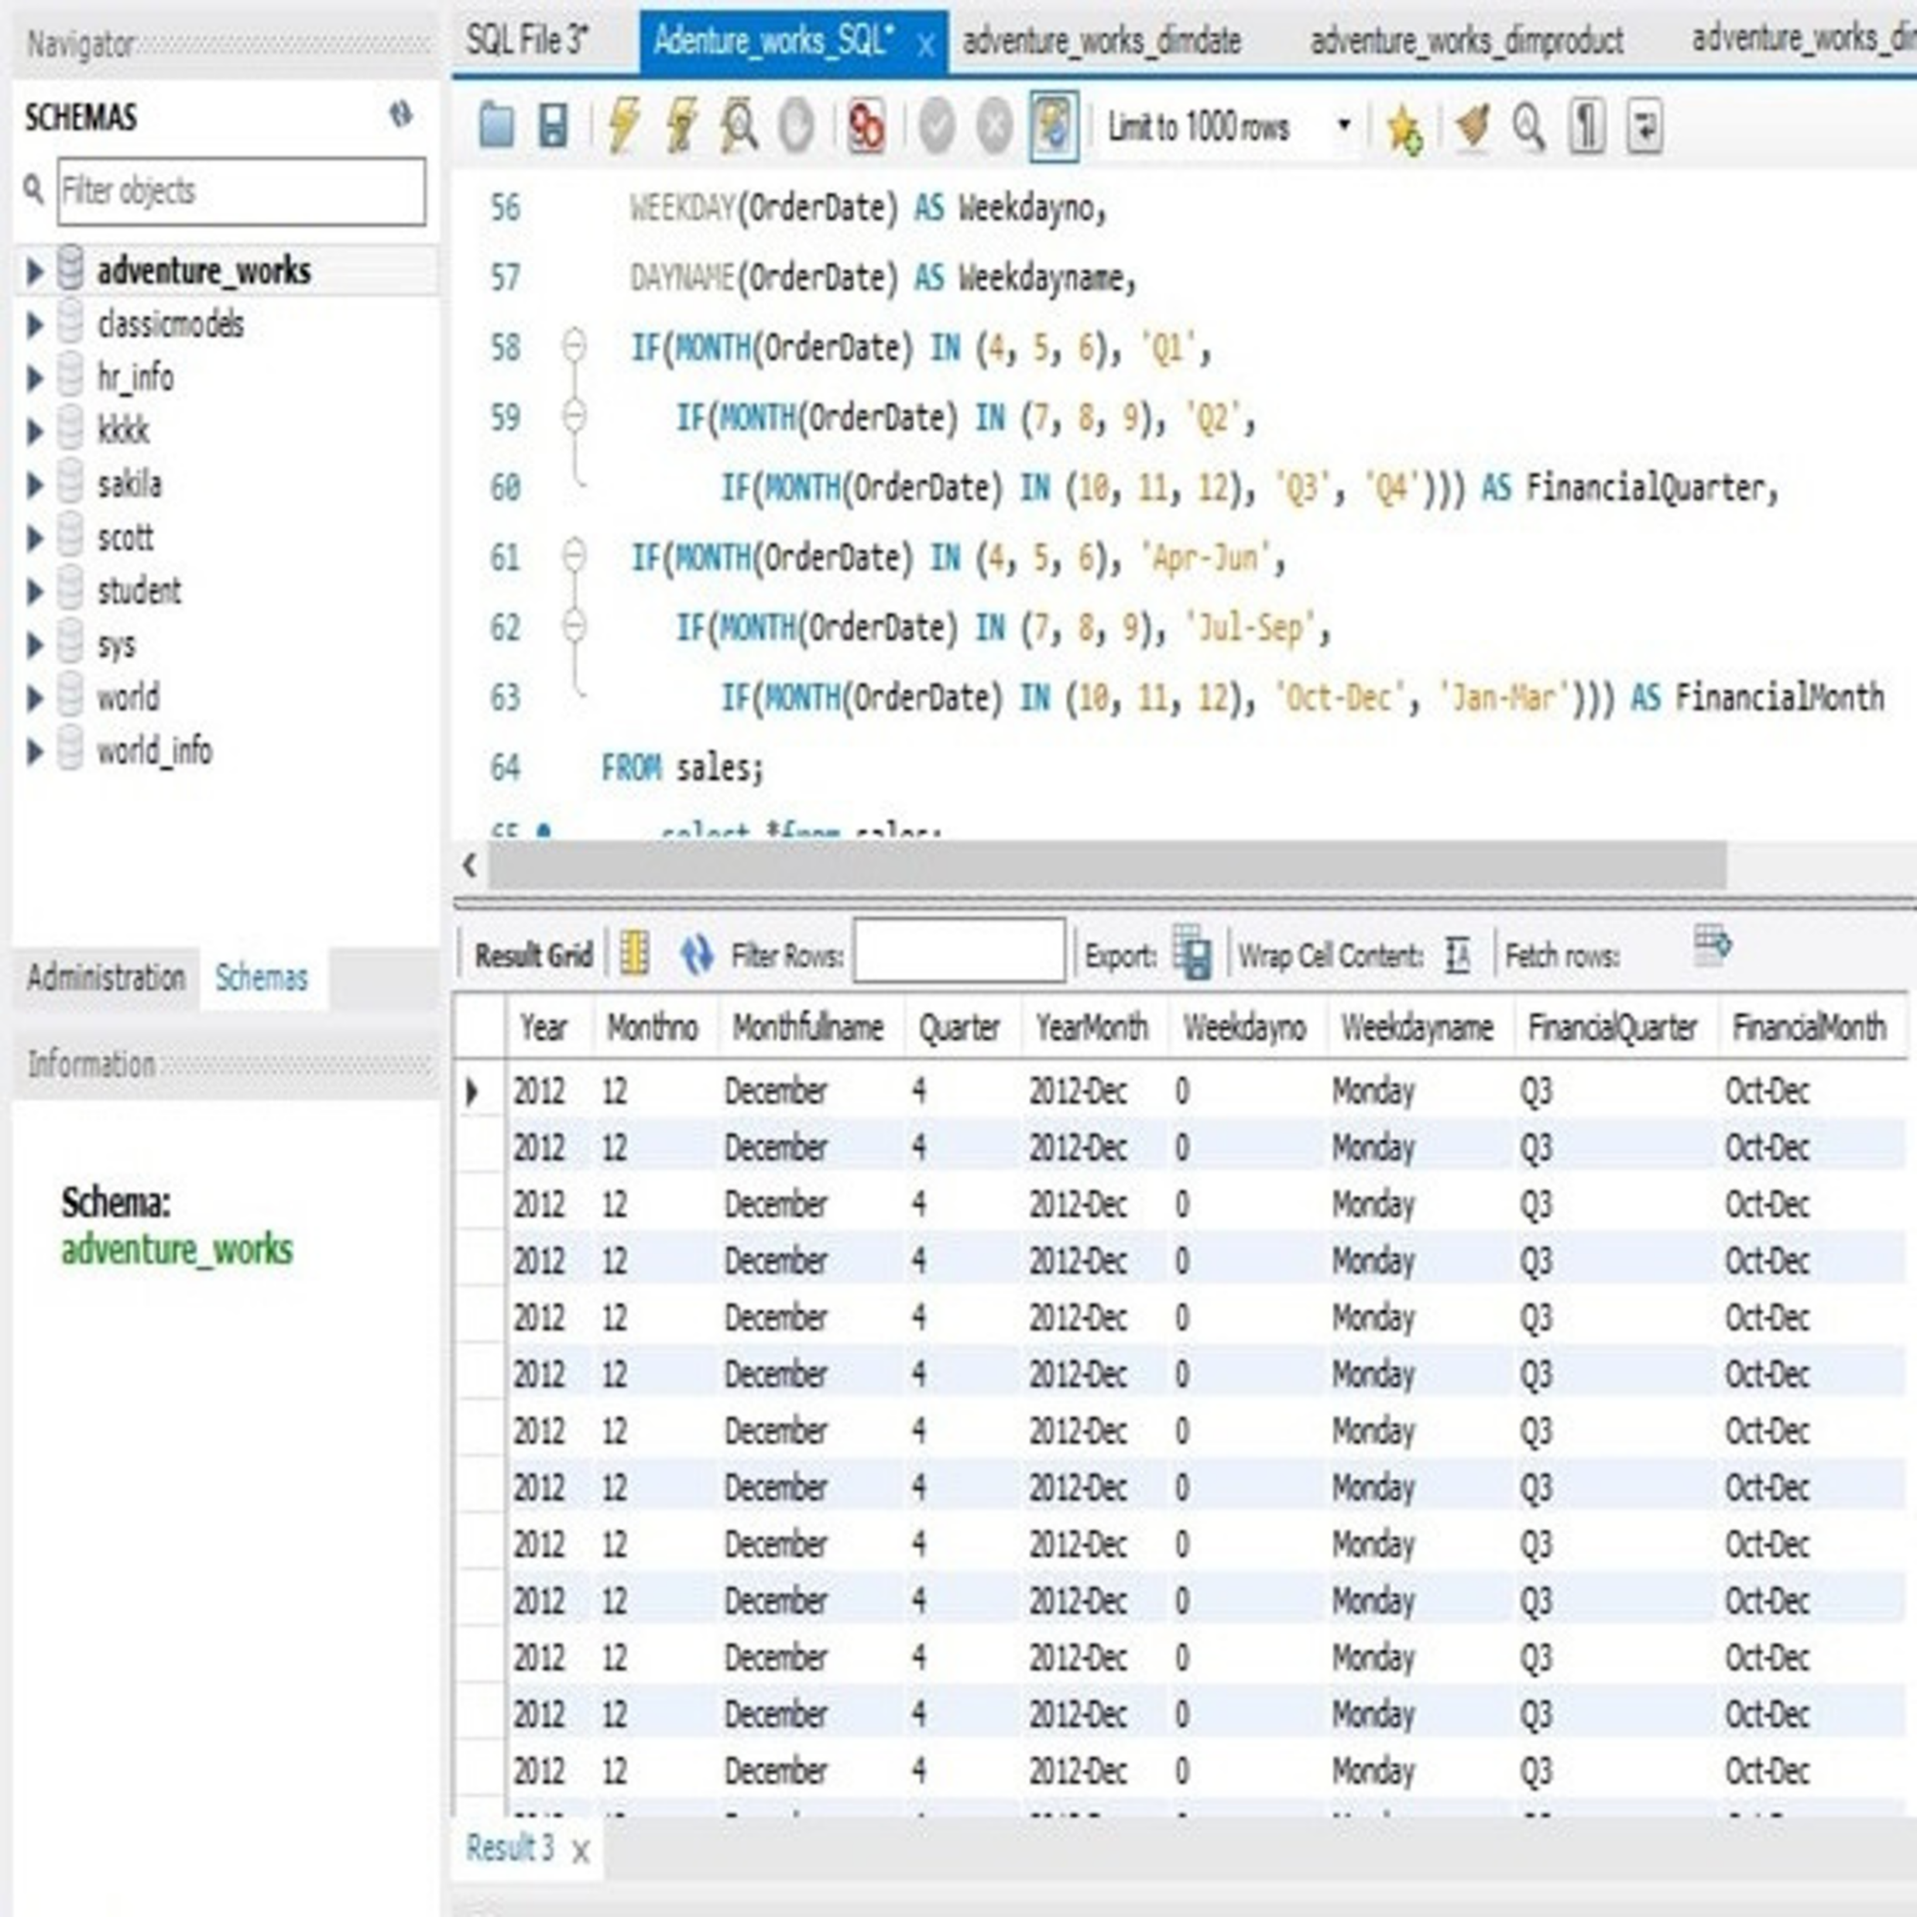
My SQL
Queries
Output

Slide 8
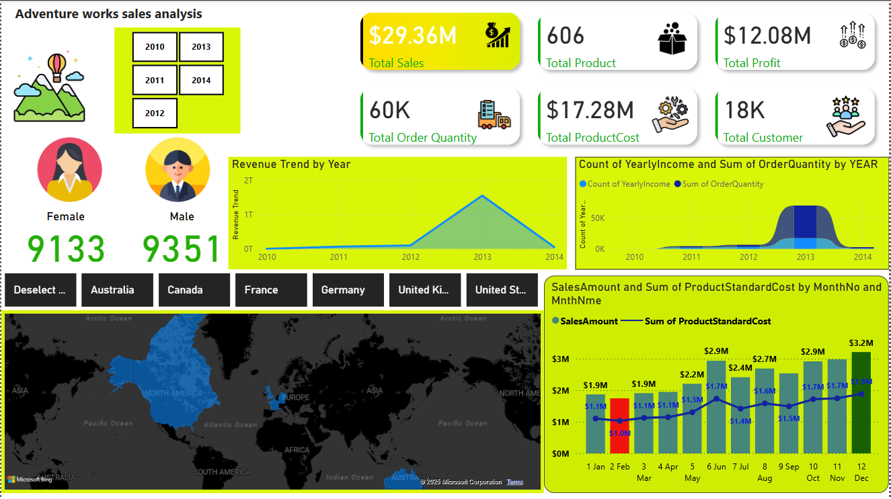
Power BI Dashboard

Slide 9

Project Summary
Adventure Works Cycles Sales Analysis
Utilized Excel, Power BI, MySQL, and Tableau to analyze sales data
Integrated data from Product, Customer, and Sales tables
Calculated key fields like Sales Amount, Production Cost, and Profit
Created visualizations and dashboards to analyze sales trends
Key Learnings
Data integration and modeling
Data visualization and storytelling
SQL querying and data analysis
Dashboard creation and design
Insights-driven decision making

Slide 10


